Slide 1
Amazon Sales Analysis

Slide 2
Introduction
Welcome to the Amazon Sales Analysis Dashboard created in Power BI
This Interactive dashboard provides c comprehensive overview of key metrics and insights derived form Amazon Sales Data.
By visualizing data trends and patterns, this dashboard empowers decision-makers to make informed choices and optimize sales strategies.

Slide 3
Problem Statement
Sales management has gained importance to meet increasing competition and the need for improved methods of distribution to reduce cost and to increase profits. Sales management today is the most important function in a commercial and business enterprise.
Do ETL: Extract-Transform-Load some Amazon dataset and find for me Sales-trend -> month-wise, year-wise, yearly_month-wise
Find key metrics and factors and show the meaningful relationships between attributes. Do your own research and come up with your findings.

Slide 4
Tools & Techniques Used
For creating dynamic , Interactive dashboard – Power BI
Data extraction, Cleaning and preliminary analysis – Excel
For complex calculations and measures - DAX

Slide 5
Main KPIs
Total Revenue : This KPI shows the addition of total revenue of entire dataset.
Total Profit : This KPI shows the addition of total Profit of entire dataset.
Total Unit Sold : This KPI shows the How many unit sold

Slide 6
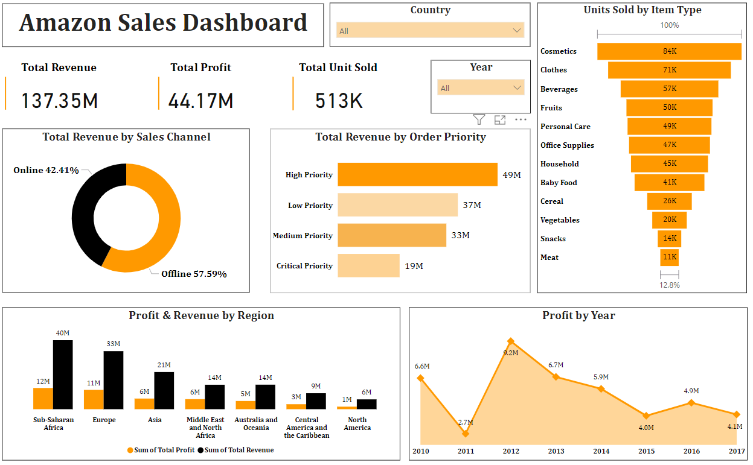
Dashboard

Slide 7
Insights
The Amazon Sales Dashboard provides insights into sales performance across various metrics. Here are some key takeaways:
Total Revenue by Sales Channel: Online sales account for 42.41% of total revenue, while offline sales account for 57.59%. * Total Revenue by Order Priority: High priority orders contribute the most revenue (49M), followed by medium priority (33M) and low priority (37M).
Profit & Revenue by Region: North America is the top region in terms of both profit (40M) and revenue (unconfirmed).
Profit by Year: Profit has steadily increased year-over-year since 2010, with 2017 being the most profitable year (unconfirmed).
Overall, the dashboard suggests that online sales and high-priority orders are driving the most revenue for Amazon. The North American region appears to be the most profitable. Profitability has also been increasing over time.

